Slide 1
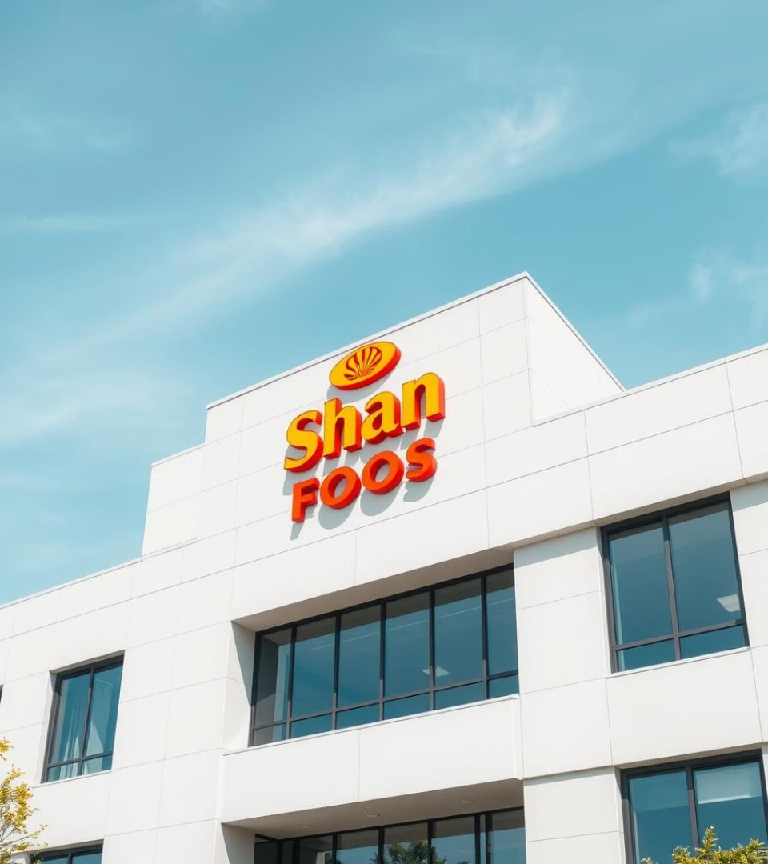
Application of Management Theories and Practices in Shan Foods Pvt. Ltd.
Fundamentals of Management Project
Instructor: Dr. Misbah Hayat Bhatti

Slide 2
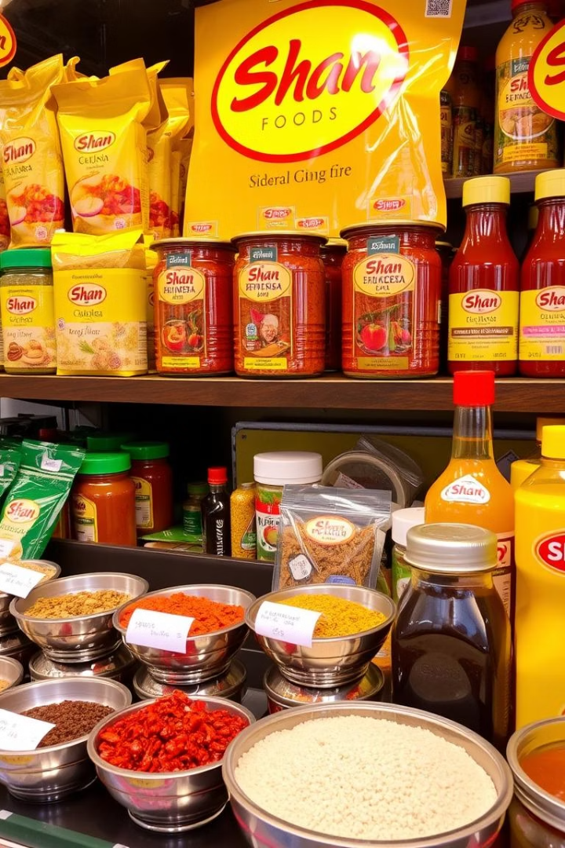
Introduction to Shan Foods
Leading Food Company
Founded in 1981 in Pakistan, exports to 65+ countries.
Objective
Explore Shan's application of management theories in practice.

Slide 3
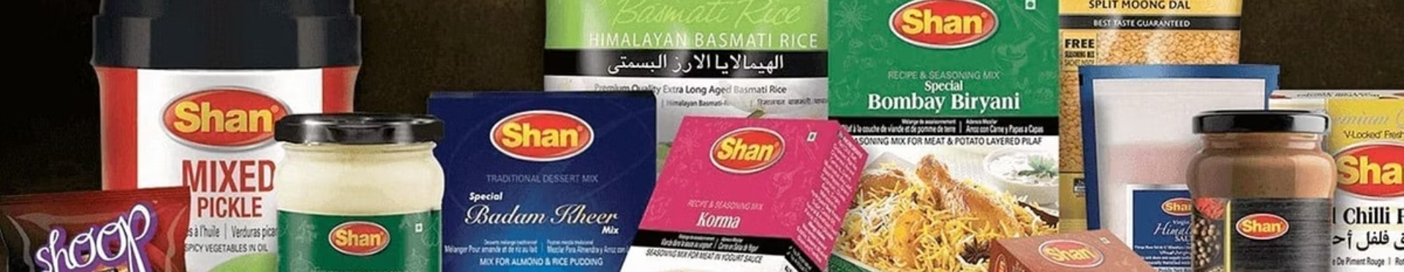

Company Overview
Founded by Sikandar Sultan
Product Range
Market Presence
Spice mixes, sauces, pickles, desserts, instant noodles.
Known for authentic taste and global reach.
Based in Karachi, Pakistan.

Slide 4

Planning at Shan Foods

Slide 5


Vision & Mission
Vision
1
Mission
Become a global leader in authentic, convenient food solutions.
Provide quality products bringing traditional flavors to every table.
2

Slide 6
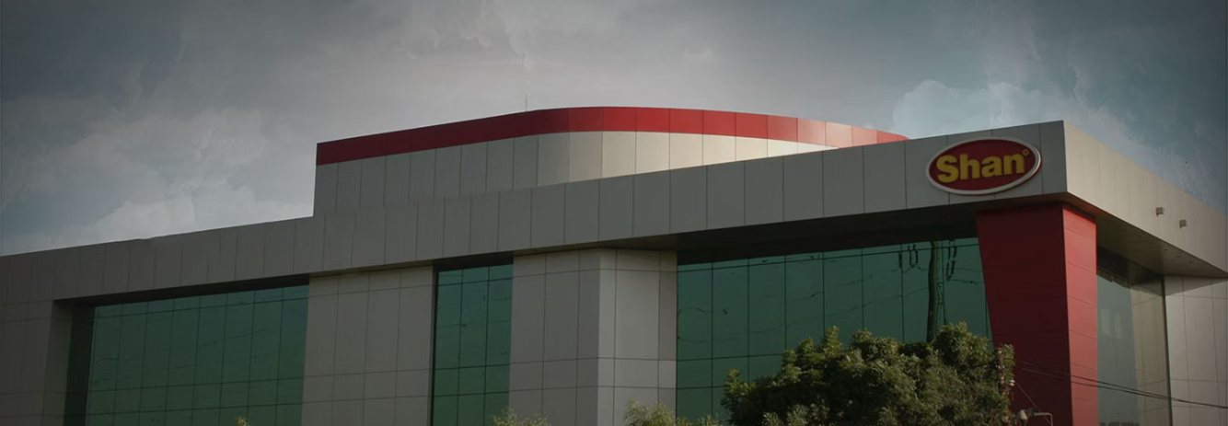
Goals & Plans
Strategic Goals
Real Goals
Financial Goals
Global expansion and brand leadership.
Maintain quality and customer trust.
Increase revenue by 10–15%.
Strategic Plans
Operational Plans
Long Term Plans
Expand Shan's product range and open new markets globally
Improve production line efficiency. Launch a new marketing campaign this year.
Open factories outside Pakistan.

Slide 7




Strategies Used
Growth Strategy
Stability Strategy
Launch new products and enter new markets.
Maintain strong position in spice mix market.
1
2
4
3
Cost Leadership
Differentiation
Quality products at competitive prices.
Unique flavors and packaging.

Slide 8
SWOT Analysis
Strengths
Weaknesses
Opportunities
Threats
Strong brand and global presence.
High competition and reliance on spice mixes.
Health trends and market growth.
Raw material costs and changing regulations.

Slide 9
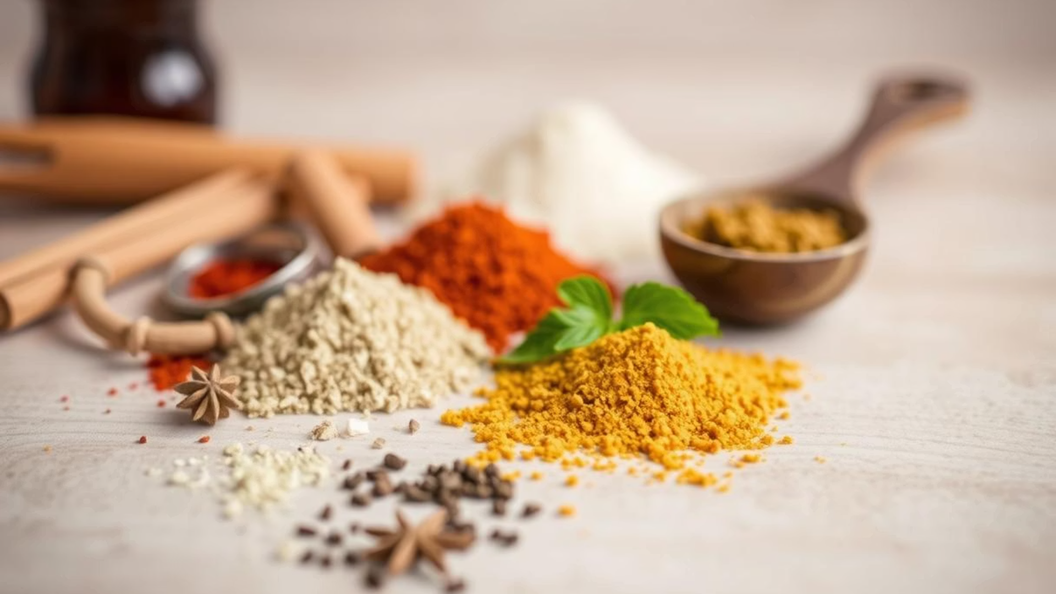






PESTEL Analysis of Shan Foods
Political
Trade and export policies impact global sales
Economic
Inflation increases production and raw material costs
Social
Growing demand for authentic traditional foods
Technology
Use of automation and advanced packaging technology
Environmental
Shift towards eco-friendly packaging solutions
Legal
Strict compliance with global food safety regulations

Slide 10
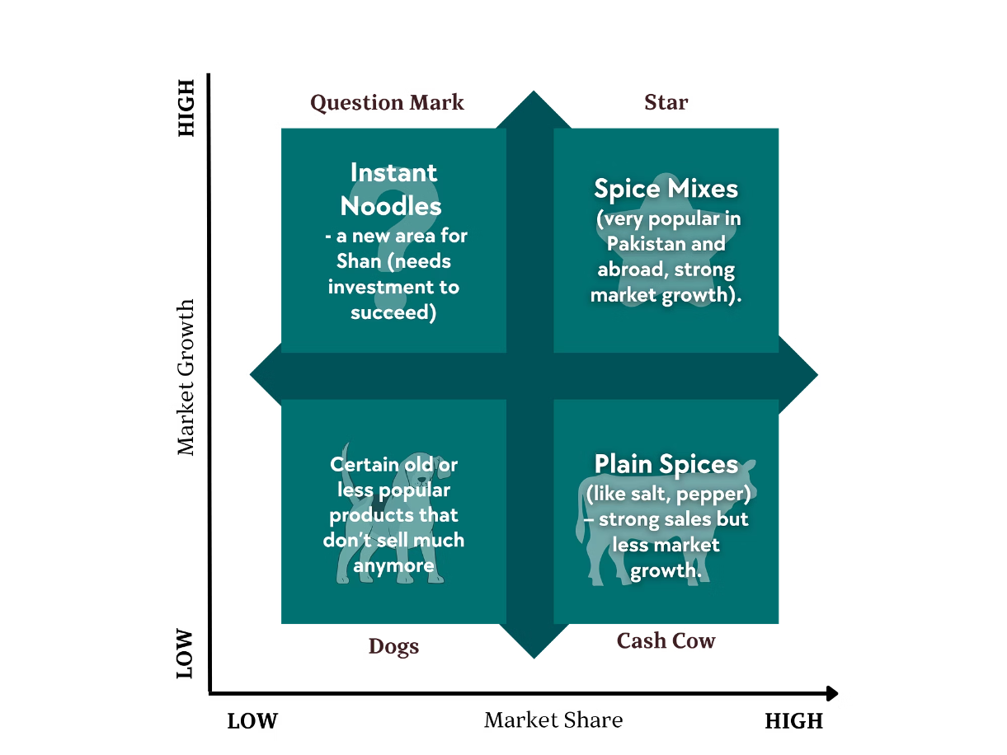
BCG Matrix
Stars: Recipe Mixes – high growth and market share
Cash Cows: Plain Spices – steady income
Question Marks: Instant noodles – potential for growth
Dogs: Low-performing or outdated products

Slide 11
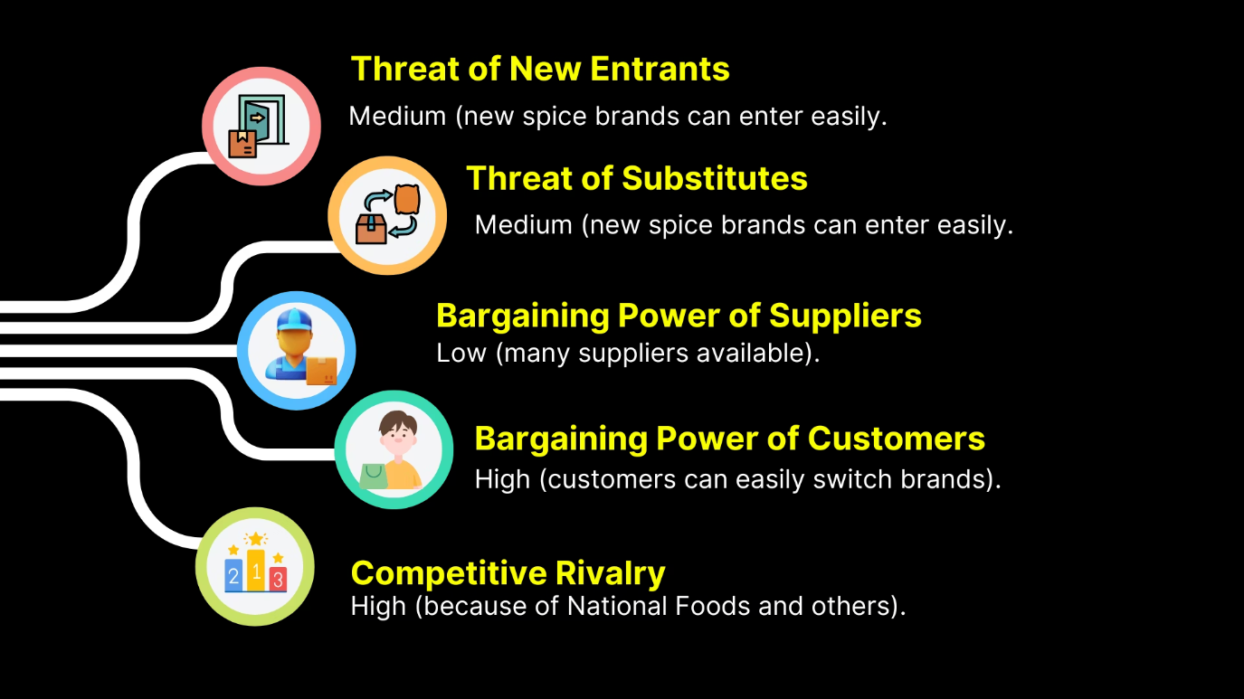
Porter 5 Forces

Slide 12
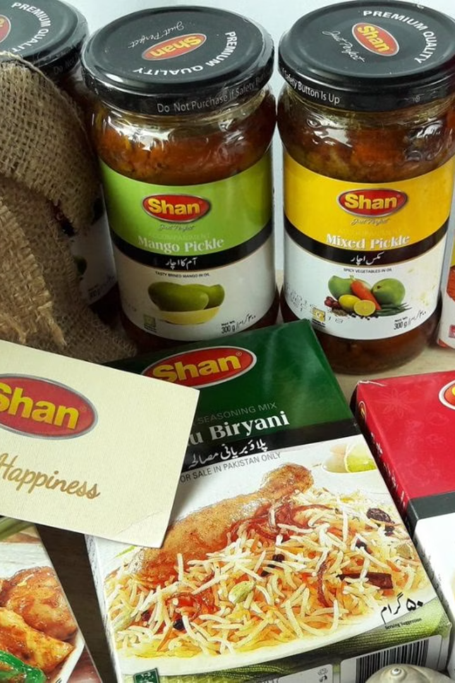
Organizational Structure at Shan Foods
Top-to-bottom hierarchical structure
CEO leads department heads
Clear reporting and responsibilities
Ensures order, discipline, accountability

Slide 13
Employees and Key Departments at Shan Foods
Over 1000 employees engaged in various specialized roles
Production Department: Handles the preparation of food products
Quality Control: Ensures safety and high product standards
Marketing and Sales: Manages product promotion and customer engagement
R&D and Export: Innovates products and oversees international markets

Slide 14

Departmentalization Model
Functional
Marketing, R&D, HR, Finance
Product-Based
Recipe Mixes, Sauces, Desserts teams
Geographical
Local vs. international markets
Process-Based
Blending, grinding, packaging stages

Slide 15

Six Elements of Structure
Work Specialization
Focused tasks (QA, R&D)
Departmentalization
Functional with product and regional divisions
Chain of Command
CEO → Heads → Managers → Staff
Span of Control
Moderate, 6–12 staff per manager
Centralization
Strategy centralized, operations partly decentralized
Formalization
High, SOPs and ISO/HACCP standards

Slide 16


Leadership at Shan Foods
Guidance
Leaders inspire and support innovation
Collaboration
Encourage openness and teamwork
Vision
Communicate company values clearly
Development
Focus on personal and professional growth

Slide 17
Leadership Style
Transformational
Inspires innovation and vision
1
2
Participative
Team involved in decisions

Slide 18
Motivational Practices
Intrinsic
Extrinsic
Purposeful work
Bonuses
Autonomy
Feedback
Idea-sharing
Training programs

Slide 19

Incentives and Benefits
Bonuses
Annual
Project-based
Profit sharing
Benefits
Health insurance
Paid leaves
Employee discounts
Retirement plans

Slide 20
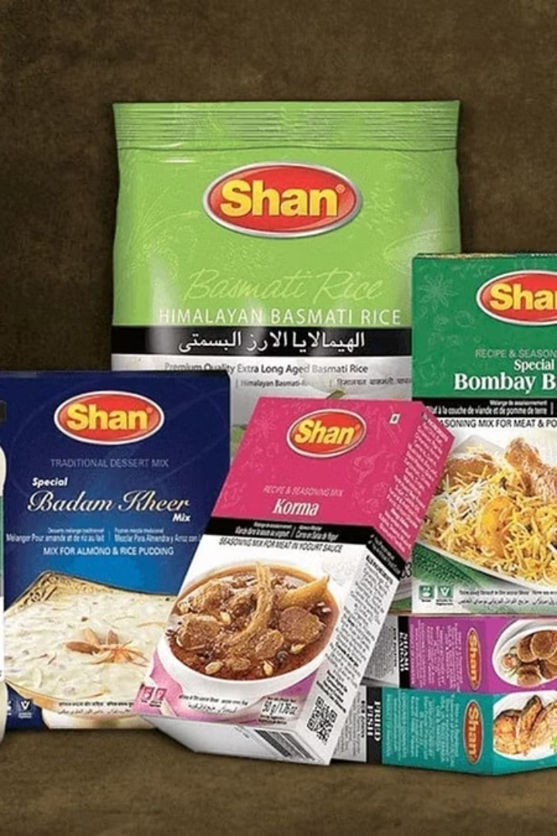
Controlling at Shan Foods
Controlling guarantees organizational goals are met effectively.
It involves monitoring, evaluating, and correcting operations continuously.
Shan Foods uses structured control to maintain quality and efficiency.

Slide 21




Controlling Processes
Set Goals
Measure Performance
Analyze Results
Take Action
Applied in production, marketing, and HR

Slide 22
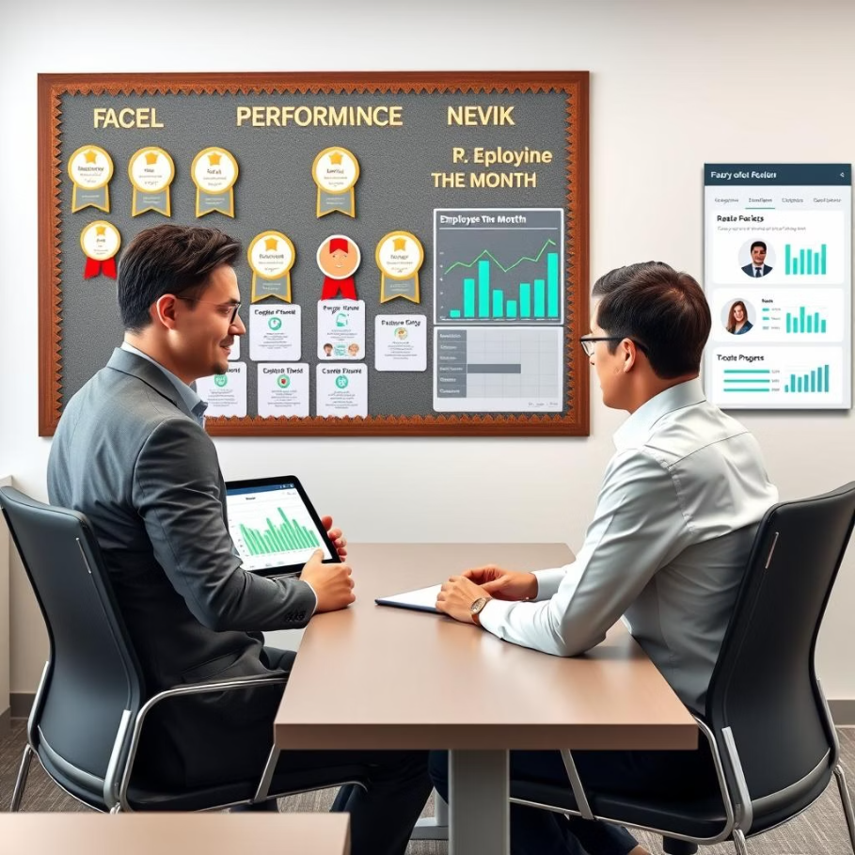
Employee Monitoring
Performance Reviews
— Bi-annual appraisals
Continuous Feedback
— Regular coaching and goal tracking
Rewards
— Bonuses and promotions for high performers

Slide 23
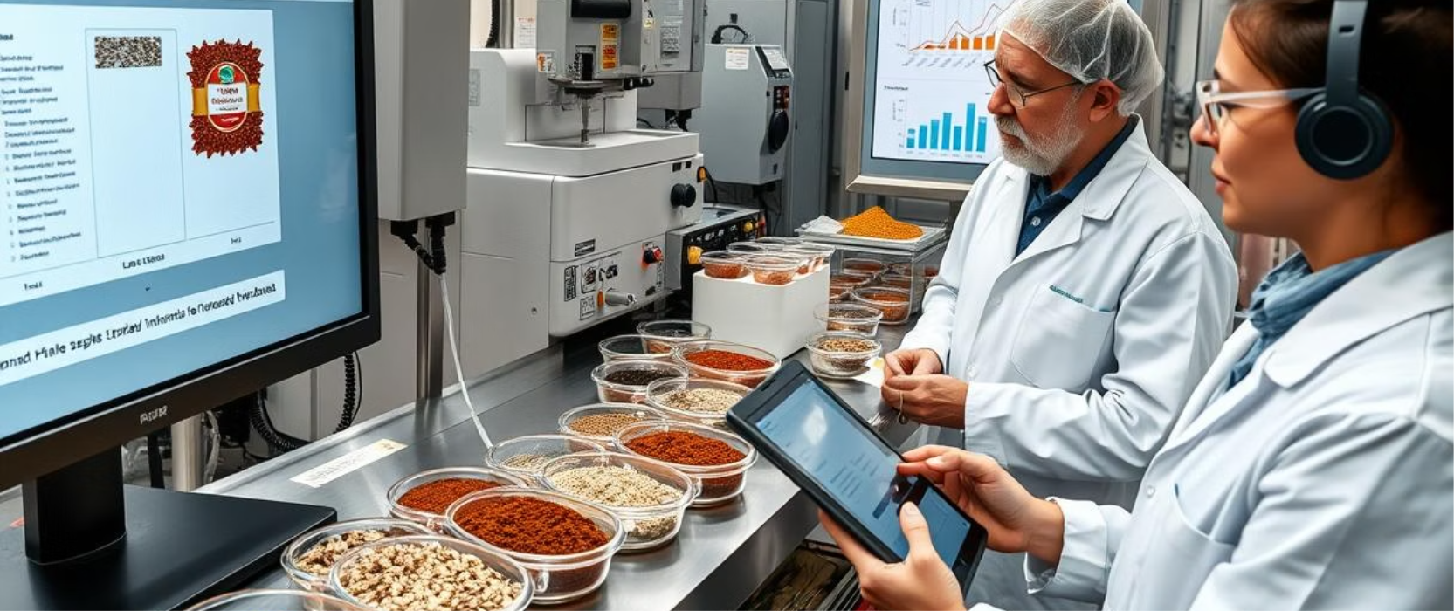
Benchmarking at Shan Foods
Internal: Comparing processes across Shan Foods' departments for consistency.
Competitive: Evaluating performance against local rivals in the spice market.
International: Measuring against global brands to adopt best practices.
Customer-Based: Using regional satisfaction metrics to improve service.
Technology: Keeping pace with the latest industry tools and innovations.

Slide 24

Thank You
We appreciate your time and attention throughout this presentation.
We look forward to discussing how Shan Foods can continue to grow and excel.
Questions?
We're ready to answer and engage with your thoughts.

